Slide 1
PowerShell 101
The No-Nonsense Beginner’s Guide to PowerShell

Slide 2


Get-Help –Name ‘about_Presenter’
Mike F Robbins
Microsoft MVP on Windows PowerShell
SAPIEN Technologies MVP
Leader & Co-Founder of Mississippi PowerShell User Group
Co-Author of Windows PowerShell TFM 4th Edition
Author of Chapter 6 in the PowerShell Deep Dives book
Winner of the Advanced Category in the 2013 Scripting Games
Learn more about me @ mikefrobbins.com

Slide 3
Write-Output ‘Questions for Audience’
IT Pro’s
Developers
PowerShell
One-Liners
Scripts
Functions
Modules
.NET Framework
Source Control
Unit Testing

Slide 4

Set-Content ‘Information to Cover’
Basics
Discoverability
Objects
Methods
Properties
Pipeline
Extending PowerShell
Remoting
Best Practices
SQL Server

Slide 5
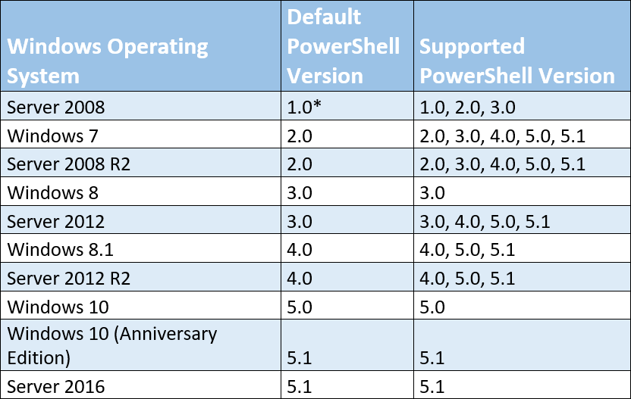
Supported PowerShell Versions by OS

Slide 6
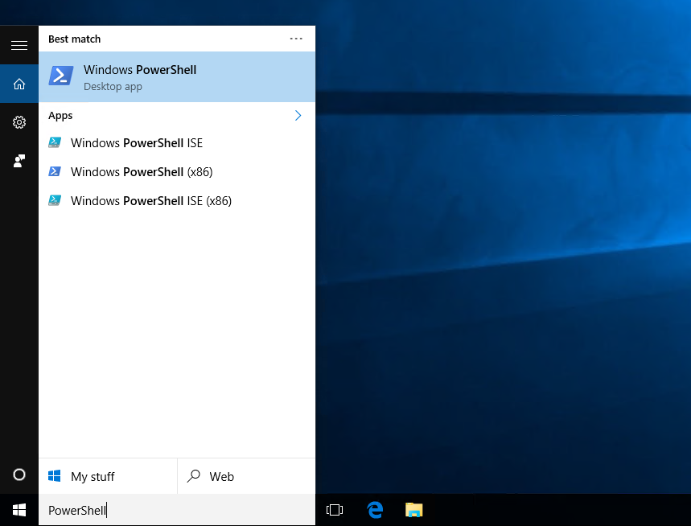
Where do I find PowerShell?
Windows 10

Slide 7
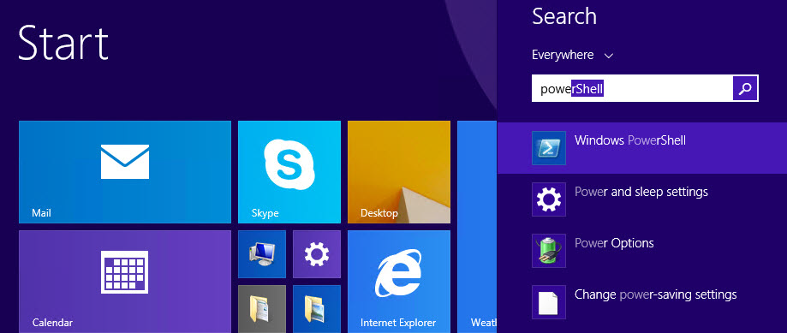
Where do I find PowerShell?
Windows 8, Windows 8.1, Server 2012, & Server 2012 R2
Accessed from the Start screen:

Slide 8
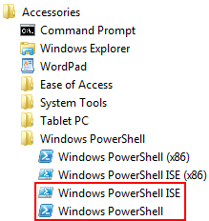
Where do I find PowerShell?
Windows 7 / Server 2008 R2 and Prior OS’s
Start > All Programs > Accessories > Windows PowerShell

Slide 9
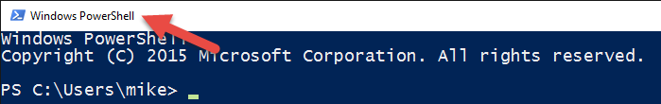
How do I start PowerShell?

Slide 10
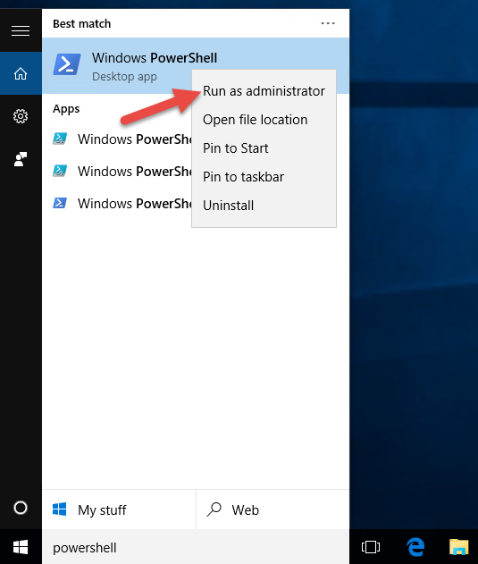
How do I start PowerShell?

Slide 11
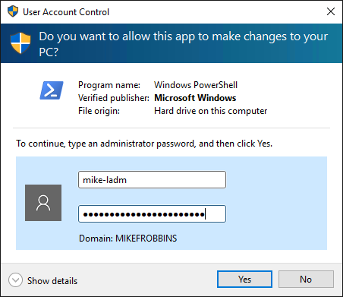
How do I start PowerShell?

Slide 12
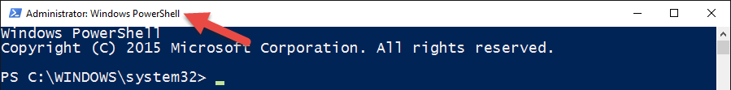
How do I start PowerShell?

Slide 13
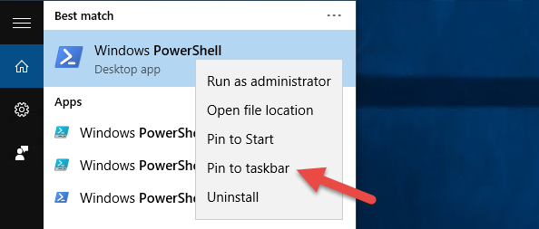
Pin PowerShell to the Taskbar

Slide 14
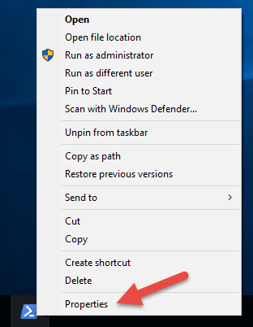
Modify the Taskbar Shortcut

Slide 15
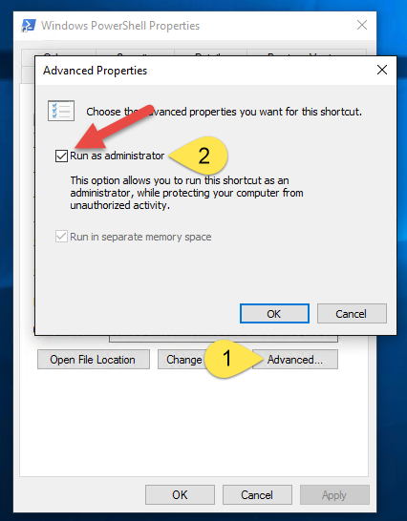
Set to always run as Administrator

Slide 16
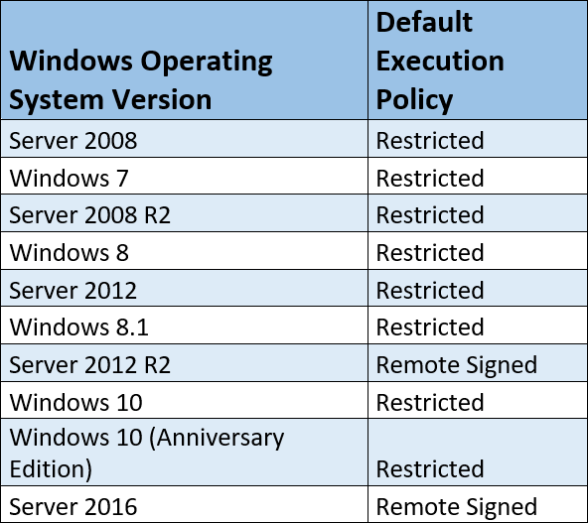
Execution Policy

Slide 17
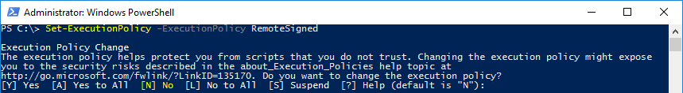
Set the Execution Policy

Slide 18
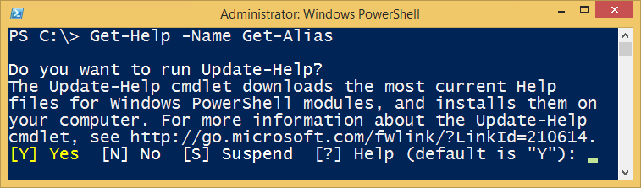
Background Information
PowerShell Commands are called Cmdlets
Cmdlet is pronounced command-let (not CMD-let)
Cmdlets are in the form of singular Verb-Noun commands
Select “Run as Administrator” when opening PowerShell
PowerShell is unable to participate in User Access Control (UAC)
Updatable Help

Slide 19
How Do I Figure Out What the Commands Are?
Core Commands for Discovering How to Use PowerShell
Get-Command
Find what commands are available
Get-Help
Figure out how to use commands
Get-Member
Discover Objects, Properties, and Methods

Slide 20
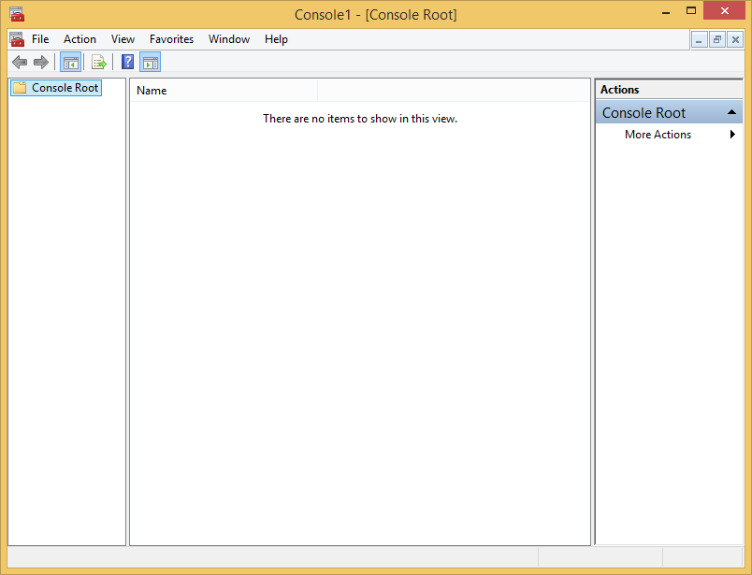
PowerShell is like the Microsoft Management Console (MMC)

Slide 21
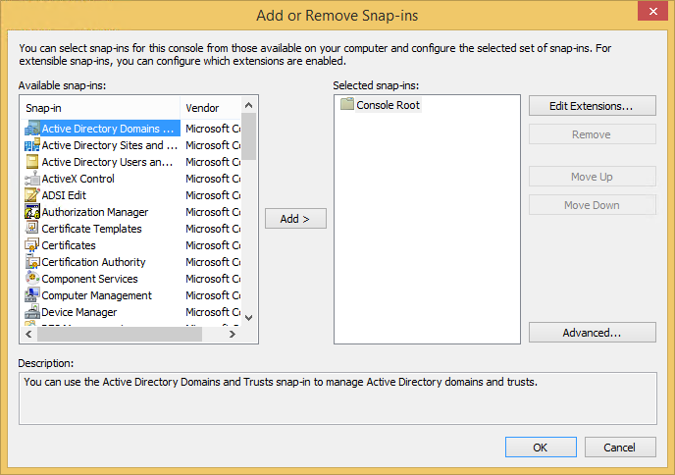
Snap-ins (and Modules) extend its functionality

Slide 22
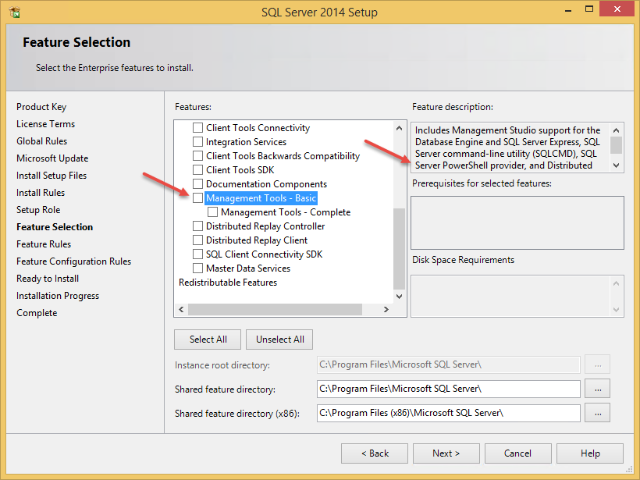
Install the SQL PowerShell Module (Old)

Slide 23
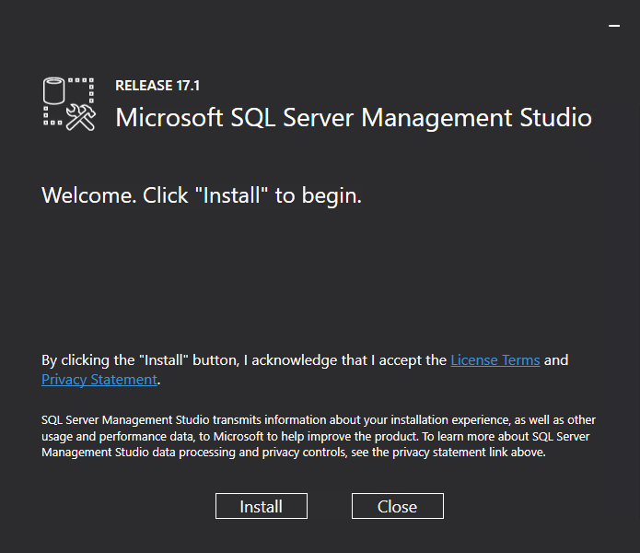
Install the SQL PowerShell Module (New)

Slide 24
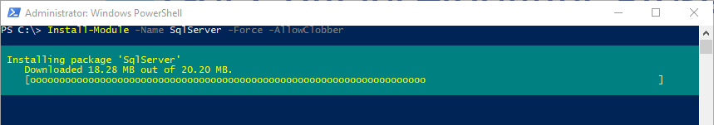
The PowerShellGet Module
Install-Module –Name SqlServer –Force -AllowClobber
PowerShellGet: The BIG EASY was to discover, install, and update PowerShell modules

Slide 25

Start-Process ‘Demo’
Demo Code: github.com/mikefrobbins/Presentations

Slide 26
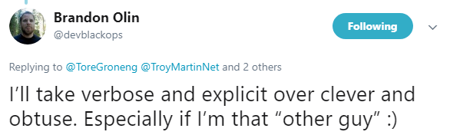
Words of Wisdom

Slide 27
Select-Object –Property ‘Resources’
PowerShell Documentation
PowerShell Best Practices and Style Guide
Microsoft Virtual Academy
PowerShell.org
GitHub
User Groups
Blogs
Twitter
Slack

Slide 28

New-Book –Name ‘PowerShell 101’
leanpub.com/powershell101

Slide 29
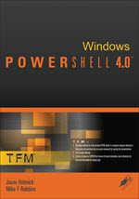
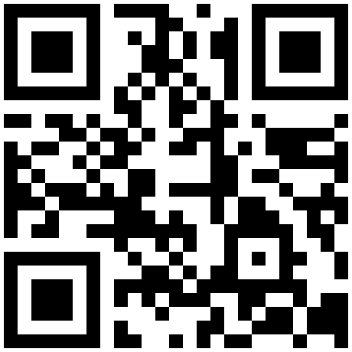

Get-Contact –Identity ‘Presenter’
Blog: mikefrobbins.com (or MrPowerShell.com)
Twitter: @mikefrobbins
LinkedIn: www.linkedin.com/in/mikefrobbins
E-Mail: See mikefrobbins.com/about/
User Group: mspsug.com (or MsPowerShell.com)

